Slide 1









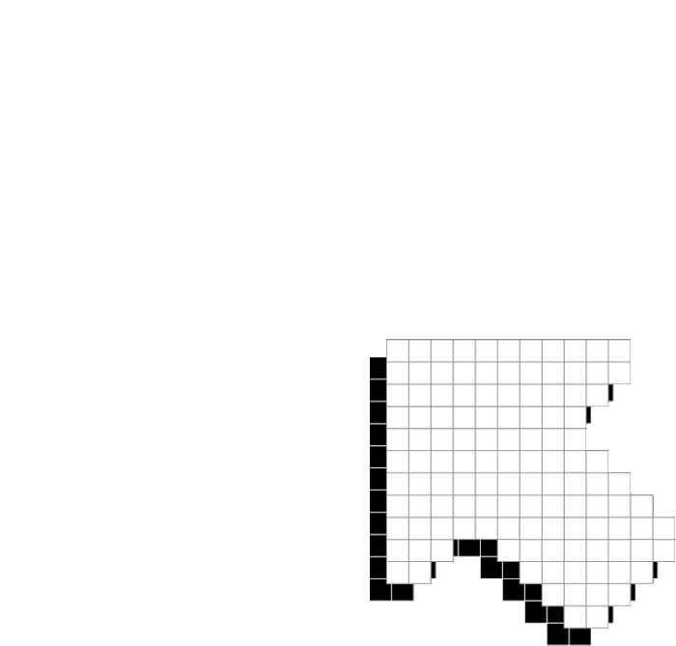



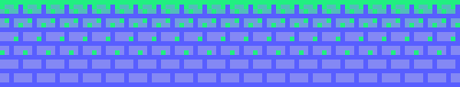
PLAYER 1
HIGHSCORE 2500
PLAYER 2
LET’S CHEM!
LETS CHEM!

Slide 2













01
07
12
PROJECT IDEAS
LAila
Human body
Eliza
Graph theory simulator
Sofia
superhero game
Tab
chemestry platform

Slide 3


PROJECT IDEAS
Person | Name | Description
Eliza | Graph Simulator | Create, visualize, and simulate graph-based structures and algorithms (discrete mathematics)
Laila | Physics of the Body | Interactive visualizer of how physics relate to the body
Sofia | Superhero Game | interactive game with forces + projectiles (physics)
Tabasuum (Chosen) | Lets Chem! | Platform game (like Super Mario Bros) with chemistry concepts for each level/mini game
 | Why chosen: | Entertaining, Interactive, Complicated (Impressive but not Impossible)

Slide 4




LAILA
01
07
12
INTERACTIVE VISUALIZER
HOW PHYSICS RELATE TO THE BODY
POINT AND CLICK FUNCTION
ZOOM IN
USER WOULD INTERACT WITH THE RELEVANT AREA
PHYSICS OF THE HUMAN BODY

Slide 5

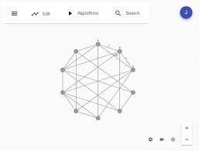

07
ELIZA
01
12
GRAPH SIMULATOR
Create, visualize, and simulate graph-based structures and algorithms
Hard to learn the theory
More CS than math/physics/chem

Slide 6
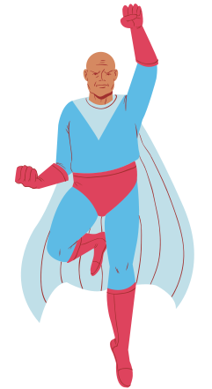

SUPERHERO GAME
SOFIA
INTERACTIVE GAME
FORCES + PROJECTILES
GOAL: LAST THE MOST TIME IN THE GAME
HARD TO CODE A GAME THAT COULD GO ON INFINITELY

Slide 7








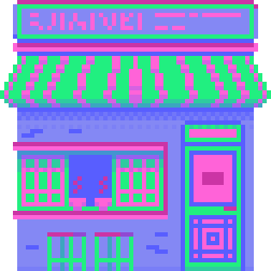
CHEMISTRY
CONCEPTS

Slide 8
NEUTRALIZATION
STOICHIOMETRY
GASES
NOMENCLATURE
CONCEPTS
PHOTOSYNTHESIS
The main aspects of the concept that the problem addresses is all chemistry related. In particular, they address problems that were encountered during the General Chemistry course at Vanier College (202-NYA-05).
This includes:
THE PERIODIC TABLE
MOLAR MASS AND MOLE CONVERSIONS
PERIODIC TRENDS
CELLULAR RESPIRATION
THE ATOM
ENERGY

Slide 9

PROPOSED SOLUTION
01
07
12
420-201-RE
420-202-RE
420-203-RE
+
+
CREATE AN ENGAGING AND INTERACTIVE GAME-LIKE PROGRAM THAT WILL:
Test knowledge about chemistry concepts and help with revision
avatar will overcome obstacles
the obstacles = chemistry problems
problems must be solved to move on

Slide 10
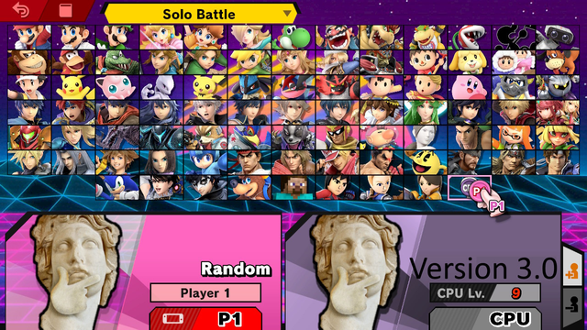
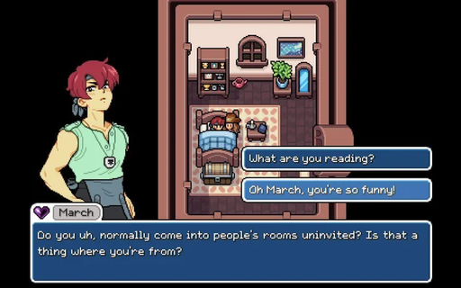
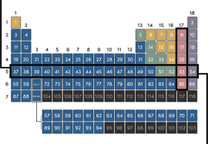
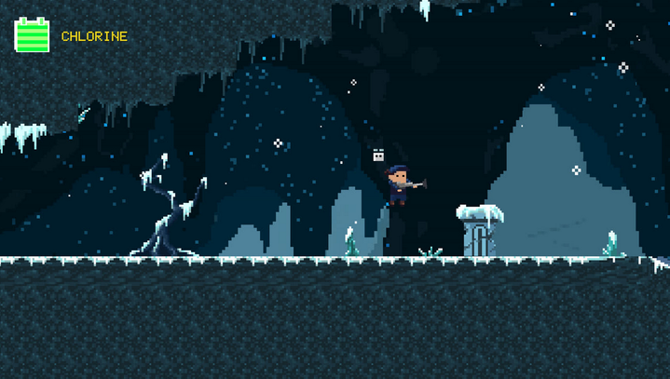
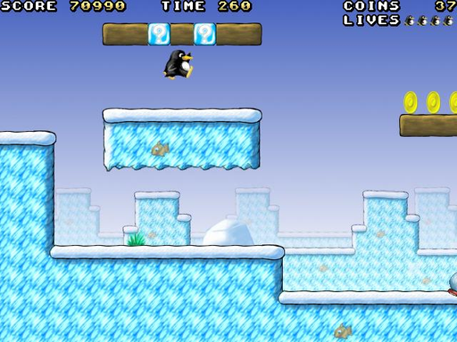
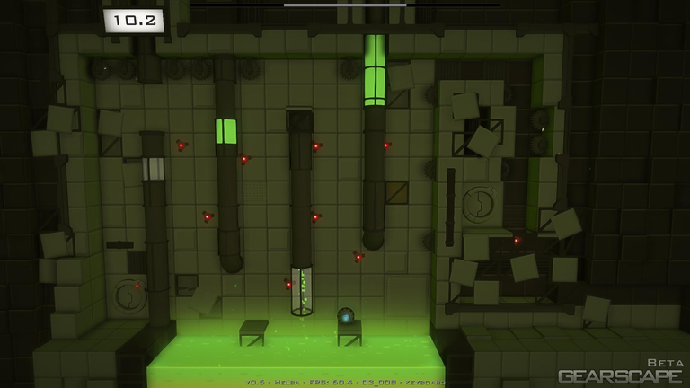
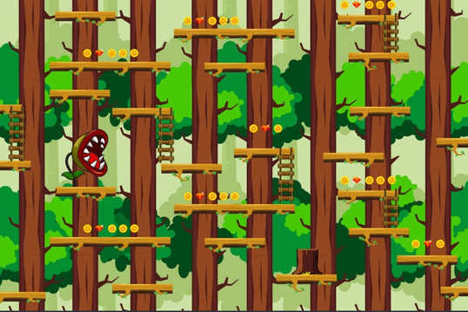
EXPECTED OUTPUT
LETS CHEM
login

Slide 11
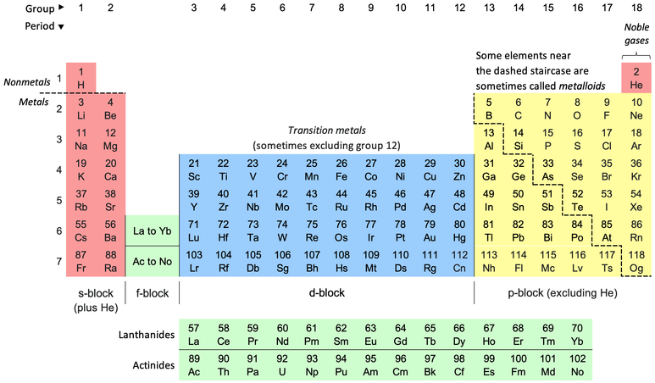
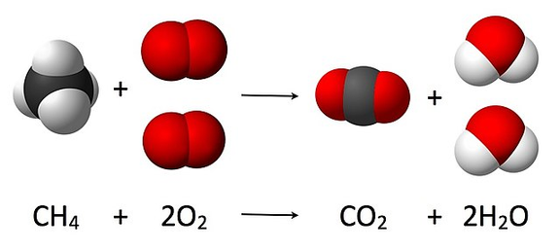
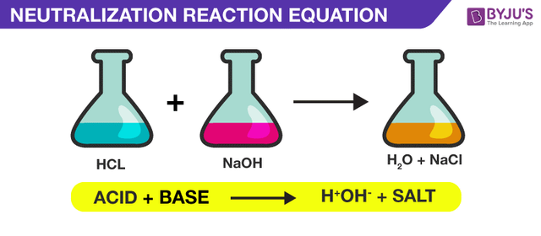
Period/Family -> Element
Determine the element -> find electrons and protons to pass to next level
LEVEL
1-2-3
Stoichiometric
Find the missing molecule. Use the map (one world = one periodic family) to find elements and create the compound
reactions
Feed water to plant -> get sugar
Feed base to acid -> neutralization (get water and salt)

Slide 12


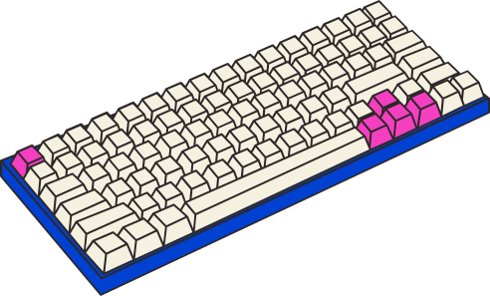
TYPICAL INPUTS
MOUSE CLICKS
KEYS ON USERS KEYBOARD

Slide 13



SOLUTION
CATEGORY
OUR PROGRAM IS DESIGNED TO BE AN
EDUCATIONAL RESOURCE
DIFFERENT THAN THE STANDARD METHODS TO LEARN
THE GOAL IS TO:
LEARN
REVISE
OUTLINE WEAKNESSES

Slide 14




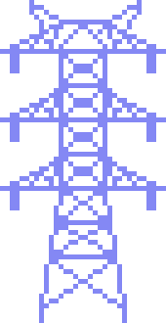
VARIABLE PARAMETERS CONTROLLING USER INTERFACE
-ANIMATION DURING REACTIONS
-POWER UPS (SPEED, X-RAY)
-USER MOVING/INTERACTIONS
-VOLUME/PAUSE/RESET
-RELEVANT SFX
-HUD

Slide 15
FEASABILITY
JavaFX UI Components
Component | Use | Component | Use | Component | use | component | Use
Canvas | Draw game objects/ background/ animations | ScrollPane | View detailed theory information | Button | Menu interactions and in-game actions | ProgressBar | Show energy levels, reaction progress, or player health
Pane (AnchorPane, BoarderPane, GridPane etc) | Organize UI components | ComboBox | Drop-down Menu | Label | Display scores, instructions etc | TextField | User input
HBox/Vbox | Structure menus, chemistry facts, and inventories | HyperLink | Ressources | CheckBox | Choose different settings (eg Dark Mode) | Shapes | For simple visual components
Scene/Stage | Manage different screens | Timeline/ Transition | Animation | ImageView/ AudioClip | Render sprites, backgrounds, sound effects | Slider | Adjust volume, or other settings

Slide 16
FEASABILITY
Implementation Components
Component | Use | Component | Use
Game Loop (Animation Timer) | Continuously update and render game animations | Particle Effects | Visualize chemical reactions (explosions, energy bursts)
Input Handling (KeyEvent, MouseEvent) | Player mouvement and object interaction | Scene Management | Switch between menu, levels, game-over screens
Entity System | Classes for Player, Enemies, Collectibles | Save/Load System | Track player progress with File I/O
Level System | Classes for organizing properties of each level/world | Score (HUD) | Visualize user’s progress and health

Slide 17
FEASABILITY
Notable team tasks
Person | Task
Tab | Movement, User Manual, Timer, UI
Eliza | Animation, Settings, Inputs, Game logic, UI
Sofia | Classes for database, Inventory, Methods for reactions, UI
Laila | Graphics, Dialogue, UI, SFX

Slide 18
FEASABILITY
Timeline
iDeal Schedule | Features to be completed
Today (Week 3) | Have project plan in order
Week 3-5 | Create all relevant classes, Basic working program, Story Board, Movement, Basic UI, inputs
Weeks 5-9 | Main implementation: database classes, art/graphics are finished, world/level classes have working methods, have all dialogue written, all graphics/art completed
Weeks 9-11 | Further polishing: working HUD, implementing power ups and how they affect interface
Weeks 11-12 | Program fully working, bug testing

Slide 19
Project Structure
GAME
LETS
Laila
Eliza
Tab
Sofia
LOGIN
MAIN (MENU)
LEVEL GAMES

Slide 20
Project STRUCTURE
LETS
Laila
Eliza
Tab
Sofia
MAIN (MENU)
User Manual
UI Main
UI dialogues
Sound Effects
Classes to manage the data
Level Games
Settings
Graphics
Story
Database
Chemical reactions + Periodic table

Slide 21
Project STRUCTURE
LEVEL GAMES
LETS
Laila
Eliza
Tab
Sofia
User Manual
Game Logic/Animation
Timer
UI Games
Level/World Class
Power-ups Class
Classes to manage the data
UI dialogues
Backpack
Database
Chemical reactions + Periodic table
Sound Effects
Settings
HUD
Lives/Score/Level
Graphics
Story

Slide 22
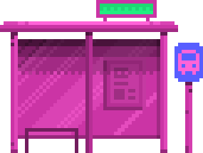
THANK YOU!

Slide 23
LET’S CHEM
Coming to Your Computers
May 2025

